Slide 1
Introduction to Redfish
DMTF Scalable Platforms Management Forum
May 2016

Slide 2
Disclaimer
The information in this presentation represents a snapshot of work in progress within the DMTF.
This information is subject to change without notice. The standard specifications remain the normative reference for all information.
For additional information, see the Distributed Management Task Force (DMTF) website.

Slide 3
What is Redfish?
Industry Standard RESTful API for IT Infrastructure
HTTPS in JSON format based on Odata v4
Equally usable by Apps, GUIs and Scripts
Schema-backed but human-readable
Version 1 focused on Servers
A secure, multi-node capable replacement for IPMI-over-LAN
Add devices over time to cover customer use cases & technology
PCIe Switching, Local Storage, NVDIMMs, Multifunction Adapters, Composability
Intended to meet OCP Remote Machine Management requirements
Expand scope over time to rest of IT infrastructure
Working with SNIA to cover more advanced storage.
Plan on working with partners like the Green Grid to cover Power/Cooling
Goal is to accommodate or map existing switch standards over time.

Slide 4
Scalable Platforms Management Forum (DMTF Group that Defines Redfish)
Co-Chairs: Jeff Autor (HPE), Paul Vancil (Dell)
Leadership Companies
Supporting Companies
AMI, Cisco, Fujitsu, Western Digital, Huawei, IBM, Insyde Software, Mellanox, NetApp, Oracle, Microsemi, Qualcomm, Seagate
Industry Alliance Partners
OpenCompute Project
UEFI - Collaborating on Firmware Update and Host Interface work
SNIA – Collaborating on Storage modeling / alignment between SSM and Redfish
TGG – Pursuing relationship to work on Power/Cooling (existing DMTF Alliance Partner)
May 17, 2016
4
Notes:
4

Slide 5
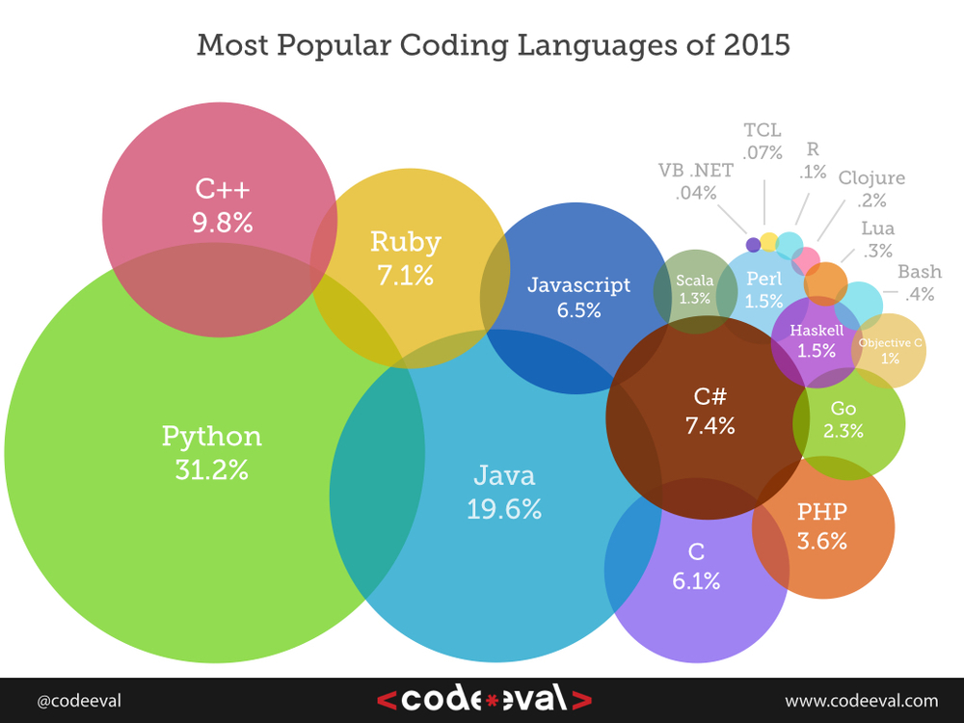
Why REST, HTTP and JSON?
REST: The API architecture
Rapidly replacing SOAP
HTTPS: The Web protocol
Well-understood by admins
Known security model
Known network configuration
JSON: Modern data format
Human-readable
Simpler than XML
Modern language support
The combination of language support and ubiquity of REST, HTTP and JSON means that systems management tasks can be performed using the same skill set and tool chain as all other IT and dev/ops tasks.

Slide 6
How simple is REST using JSON?
Example Python code to retrieve serial number from a server:
rawData = urllib.urlopen(‘http://192.168.1.135/redfish/v1/Systems/1’)
jsonData = json.loads(rawData)
print( jsonData[‘SerialNumber’] )
Output is:
*Example uses Redfish ComputerSystem resource, Authentication not shown
1A87CA442K

Slide 7
Redfish v1.0 Feature Set
Retrieve “IPMI class” data
Basic server identification and asset info
Health state
Temperature sensors and fans
Power supply, power consumption and thresholds
Basic I/O infrastructure data
Host NIC MAC address(es) for LOM devices
Simple hard drive status / fault reporting
Perform Common Actions
Reboot / power cycle server
Change boot order / device
Set power thresholds
Access and Notification
Serial console access via SSH
Alert / event notification method(s)
Event Log access method(s)
Discovery
Service endpoint (network-based discovery)
System topology (rack/chassis/server/node)
BMC infrastructure
View / configure BMC network settings
Manage local BMC user accounts
Security
Session-based leverages HTTPS
Working on more…

Slide 8
Redfish releases
v1.0 Released August 2015
Specification and Schema files
v1.1 Release November 2015
Spec 1.0.1, Schema 1.1, 1.0.1 and 1.0
2016.1 Release April, 2016
Spec 1.0.2, Schema 1.2, 1.1, 1.0.2 and 1.0
Releases planned for Schema and Specification
2016.2 - Summer 2016 (August)
2016.3 - Fall 2016 (December)
Expecting 3 releases per year.
Each release will have updates, errata and additions that are ready at that time
Download specification, white paper, FAQ, schemas, Works in Progress:
http://www.dmtf.org/standards/redfish

Slide 9
Redfish 2016 Release 1
Redfish Specification v1.0.2 (errata)
NEW Schemas v1.0.0
AttributeRegistry, Bios, Drive, Memory, MemoryCollection, MemoryMetrics, SecureBoot, Storage, StorageCollection, Volume
Schemas v1.1.0 or v1.2.0 (minor revs)
Chassis, ComputerSystem, Event, Manager, Power, Resource, SimpleStorage, Thermal
Schemas v1.x.2 (errata)
Schema Release Bundles (posted at http://www.dmtf.org/standards/redfish)
DSP8010_2016.1: All new, minor, and errata 2016.1 schemas
Individual file contents also posted on http://redfish.dmtf.org/schemas
DSP8010_2016.0.9a: Work in Progress
New schemas under development within SPMF

Slide 10
Expected Redfish Open Source Efforts
Conformance Tool Client Library
Common utility support functions
Discovery, Enumeration, etc.
Event subscription
Typical tasks
Power on/off/reboot
Gather thermal data
Languages under consideration
Python
Java
PowerShell
Other possibilities…
Command Line Utility
Similar to IPMItool
Designed for end users
Calls Client library
Likely written in Python
Conformance Test Suite
Schema validation (JSON and CSDL)
Payload validation
Spec and Schema conformance
Checklist for vendors and customers
Avoid spec interpretation conflicts

Slide 11
Introduction to the Redfish data model
All resources linked from a Service Entry point (root)
Always located at URL: /redfish/v1
Major resource types structured in ‘collections’ to allow for standalone, multi-node, or aggregated rack-level systems
Additional related resources fan out from members within these collections
ComputerSystem: properties expected from an OS console
Items needed to run the “computer”
Roughly a logical view of a computer system as seen from the OS
Chassis: properties needed to locate the unit with your hands
Items needed to identify, install or service the “computer”
Roughly a physical view of a computer system as seen by a human
Managers: properties needed to perform administrative functions
aka: the systems management subsystem (BMC)

Slide 12
Resource map (highlights)
/redfish/v1
/redfish/v1/Systems
Root Resource
Collection of Systems
/redfish/v1/Systems/<id>
Links to all content
“Logical” view of the system
1..n
Server Information
Model #, Serial #, Boot Order, NIC MAC, status, etc.
Sessions
Accounts
/redfish/v1/Chassis
Processors
Schemas
Collection of Chassis
Disks
“Physical” view of the system
NICs
Events
/redfish/v1/Chassis/<id>
/redfish/v1/Managers
1..n
Chassis
Collection of Managers
Chassis global physical asset info
BMC functionality
Power
Thermal
/redfish/v1/Managers/<id>
1..n
BMC
System Manager operations
Services
Logs

Slide 13
More on Redfish:
Join the SPMF
Help shape the standard
http://www.dmtf.org/join/spmf
We want your Feedback
On the Standard or Works in Progress
http://www.dmtf.org/standards/feedback
Redfish Standards
Schemas, Specs, Mockups, White Papers, FAQ, Educational Material & more
http://www.dmtf.org/standards/redfish
Redfish Developer Portal
Redfish Interactive Explorer, Hosted Schema at Namespace & other links
http://redfish.dmtf.org
SPMF (WG that defines Redfish)
Companies involved, Upcoming Schedules & Future work, Charter, Information on joining.
http://www.dmtf.org/standards/spmf

